Slide 1

Advanced Probabilistic Machine Learning
Ralf Herbrich, Rainer Schlosser
Approximate Inference: Variational Inference

Slide 2
Overview
Minimizing Reverse KL-Divergence via ELBO
Variational Inference for Gaussian Factors
Application: Robust Bayesian Regression and Ranking
Mixture Models

Slide 3
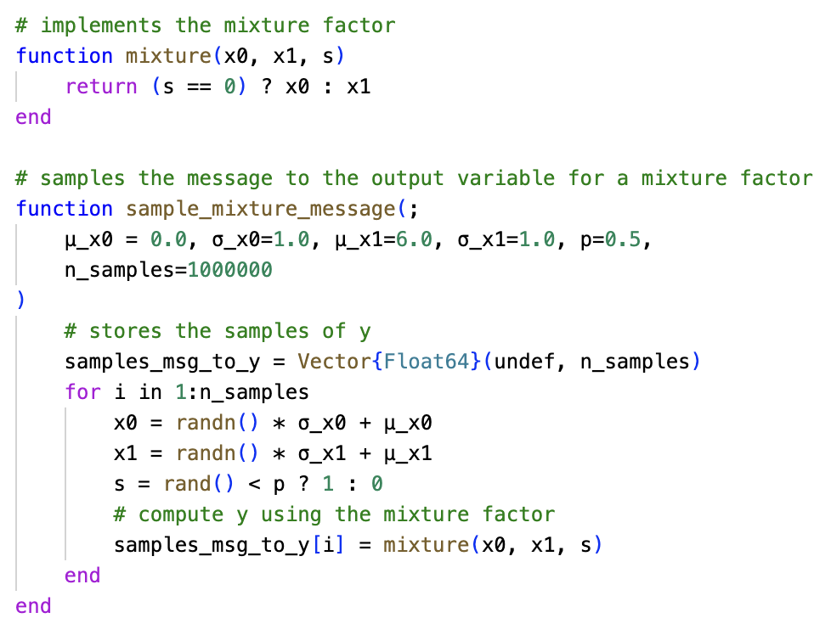



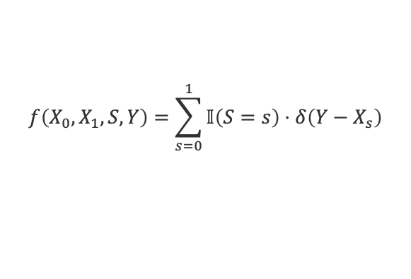



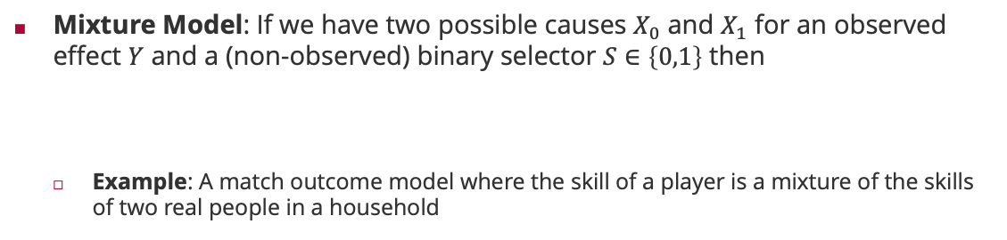










Motivation: Mixture Models
Mixture Model: If we have two possible causes $X_{0}$ and $X_{1}$ for an observed effect $Y$ and a (non-observed) binary selector $S∈\left\{0,1\right\}$ then
Example: A match outcome model where the skill of a player is a mixture of the skills of two real people in a household
$$S$$
$$X_{0}$$
$$m_{X_{0}→f}\left(⋅\right)$$
$$m_{S→f}\left(⋅\right)$$
$$f\left(X_{0},X_{1},S,Y\right)=\sum_{s=0}^{1}{𝕀\left(S=s\right)}⋅δ\left(Y−X_{s}\right)$$
$$m_{f→Y}\left(⋅\right)$$
$$=δ\left(Y−X_{S}\right)$$
$$Y$$
$$X_{1}$$
$$m_{X_{1}→f}\left(⋅\right)$$
$$δ\left(Y−X_{S}\right)$$
$$m_{X_{0}→f}\left(x_{0}\right)=𝒩\left(x_{0};0,1\right)$$
$$m_{X_{0}→f}\left(x_{0}\right)=𝒩\left(x_{0};0,1\right)$$
$$m_{X_{1}→f}\left(x_{1}\right)=𝒩\left(x_{1};6,1\right)$$
$$m_{X_{1}→f}\left(x_{1}\right)=𝒩\left(x_{1};6,1\right)$$
$$m_{S→f}\left(s\right)=Ber\left(s;0.5\right)$$
$$m_{S→f}\left(s\right)=Ber\left(s;0.75\right)$$

Slide 4















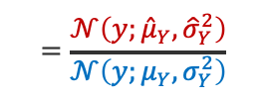
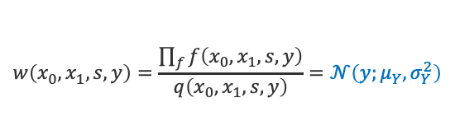

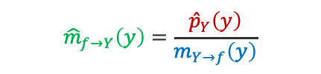


Motivation: Mixture Models (ctd)
$$Ber\left(⋅;p\right)$$
Expectation Propagation: Since the message $m_{f→Y}\left(⋅\right)$ is not a Gaussian, we approximate the marginal $p_{Y}\left(⋅\right)=m_{f→Y}\left(⋅\right)⋅m_{Y→f}\left(⋅\right)$ with ${\hat{p}}_{Y}\left(⋅\right)$ by virtue of
Idea: Instead of algebraic integration, use importance sampling with the proposal
$$X_{0}$$
$$S$$
$$𝒩\left(⋅;μ_{X_{0}},σ_{X_{0}}^{2}\right)$$
$${\hat{p}}_{Y}\left(⋅\right)=𝒩\left(⋅;E_{{Y∼p}_{Y}}\left[Y\right],{var}_{{Y∼p}_{Y}}\left[Y\right]\right)$$
$$Y$$
$$δ\left(Y−X_{S}\right)$$
$$𝒩\left(⋅;μ_{Y},σ_{Y}^{2}\right)$$
$${\hat{μ}}_{Y}$$
$${\hat{σ}}_{Y}^{2}$$
$$X_{1}$$
$$𝒩\left(⋅;μ_{X_{1}},σ_{X_{1}}^{2}\right)$$
$$w\left(x_{0},x_{1},s,y\right)=\frac{\prod_{f}{f\left(x_{0},x_{1},s,y\right)}}{q\left(x_{0},x_{1},s,y\right)}=𝒩\left(y;μ_{Y},σ_{Y}^{2}\right)$$
$$q\left(x_{0},x_{1},s,y\right)=𝒩\left(x_{0};μ_{0},σ_{0}^{2}\right)⋅𝒩\left(x_{1};μ_{1},σ_{1}^{2}\right)⋅Ber\left(s;p\right)⋅δ\left(y−x_{s}\right)$$
$${\hat{m}}_{f→Y}\left(y\right)=\frac{{\hat{p}}_{Y}\left(y\right)}{m_{Y→f}\left(y\right)}$$
$$m_{X_{0}→f}\left(x_{0}\right)=𝒩\left(x_{0};0,1\right)$$
$$m_{X_{1}→f}\left(x_{1}\right)=𝒩\left(x_{1};6,1\right)$$
$$m_{S→f}\left(s\right)=Ber\left(s;0.5\right)$$
$$=\frac{𝒩\left(y;{\hat{μ}}_{Y},{\hat{σ}}_{Y}^{2}\right)}{𝒩\left(y;μ_{Y},σ_{Y}^{2}\right)}$$
$$m_{Y→f}\left(y\right)=𝒩\left(y;3,1\right)$$
Not possible because ${\hat{σ}}_{Y}^{2}>σ_{Y}^{2}$

Slide 5
Overview
Minimizing Reverse KL-Divergence via ELBO
Variational Inference for Gaussian Factors
Application: Robust Bayesian Regression and Ranking
Mixture Models

Slide 6
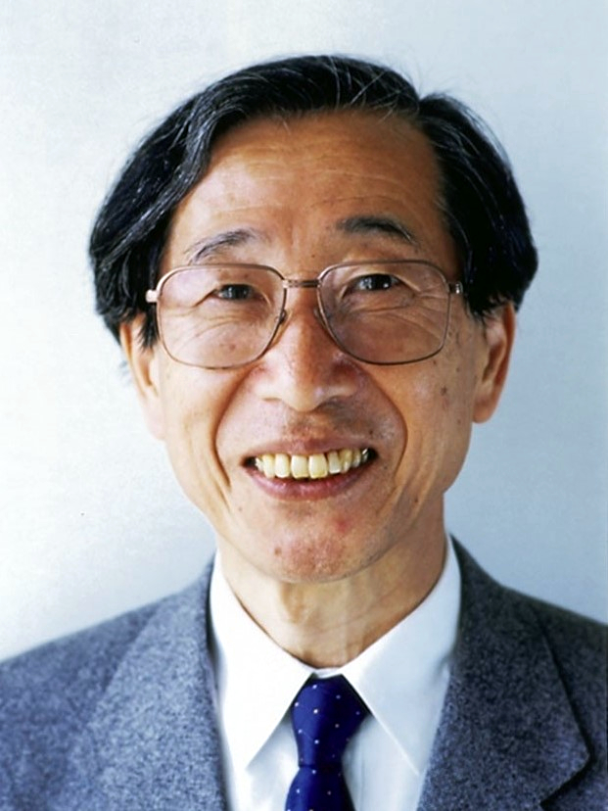



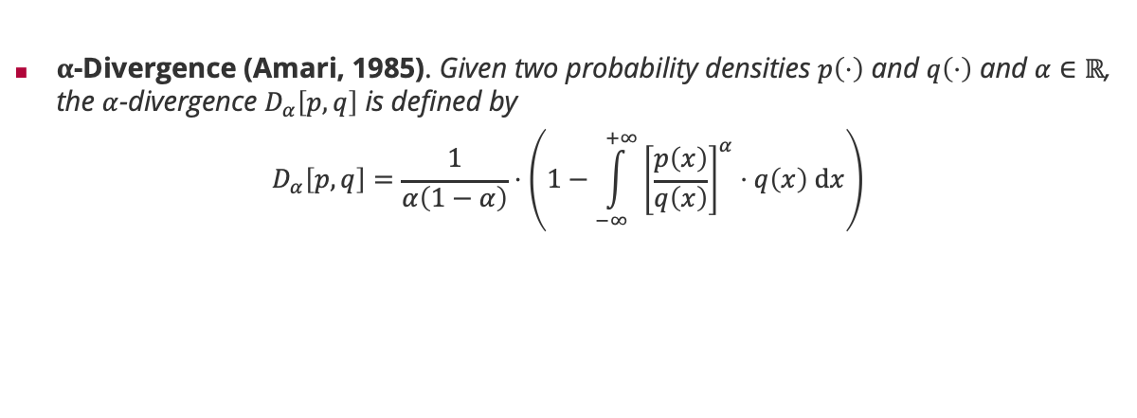




Recall: $α$-Divergence
$α$-Divergence (Amari, 1985). Given two probability densities $p\left(⋅\right)$ and $q\left(⋅\right)$ and $α∈ℝ$, the $α$-divergence $D_{α}\left[p,q\right]$ is defined by
$$D_{α}\left[p,q\right]=\frac{1}{α\left(1−α\right)}⋅\left(1−\int_{−∞}^{+∞}{{\left[\frac{p\left(x\right)}{q\left(x\right)}\right]}^{α}⋅q\left(x\right) dx}\right)$$
Shun'ichi Amari (甘利 俊) (1936)
zero-forcing & mode seeking
inclusive & support seeking
$$α$$
$$α=−∞$$
$$α=−1$$
$$α=0$$
$$α=1$$
$$α=+∞$$

Slide 7
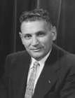
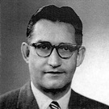
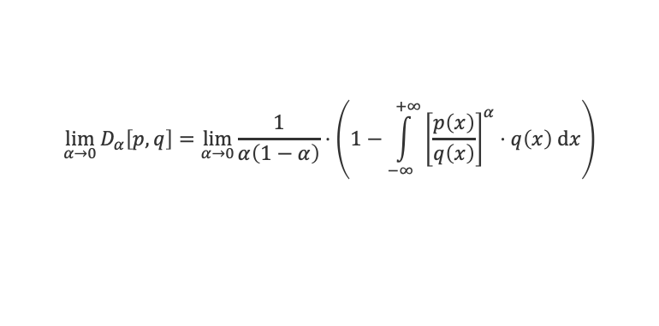
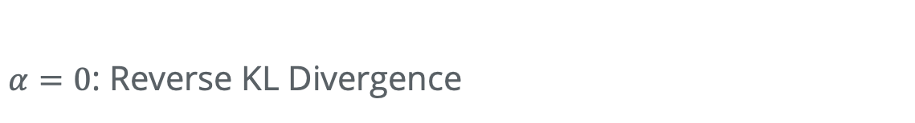
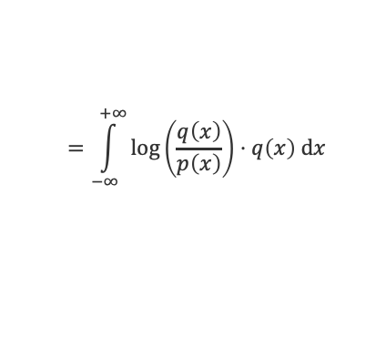
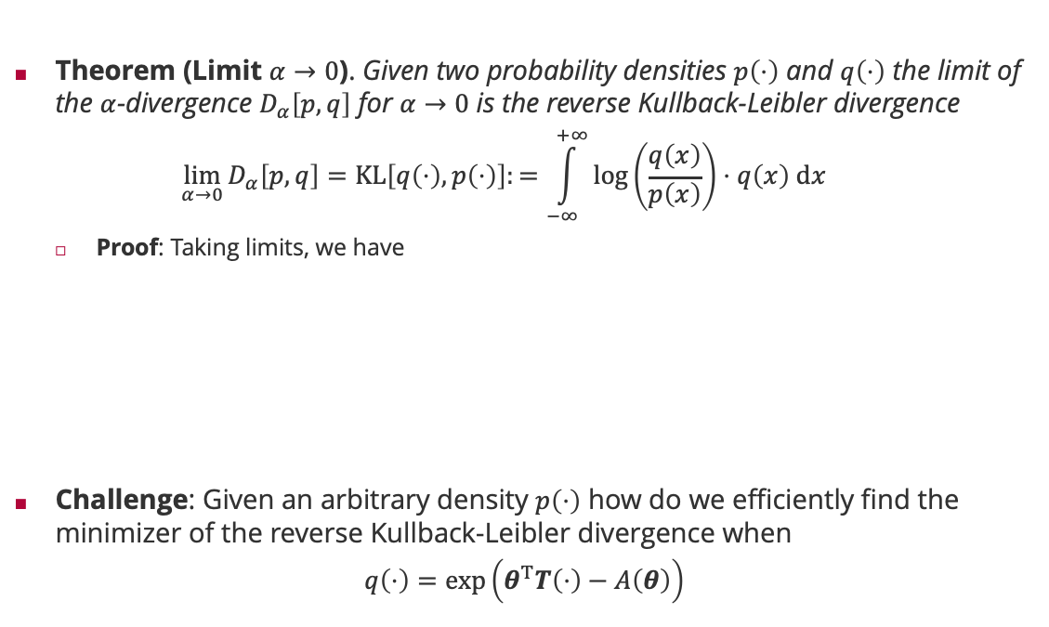
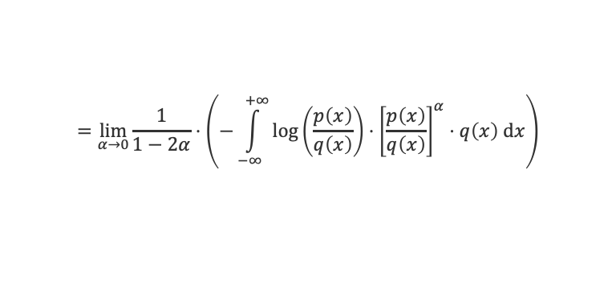


$α=0$: Reverse KL Divergence
Theorem (Limit $α→0$). Given two probability densities $p\left(⋅\right)$ and $q\left(⋅\right)$ the limit of the $α$-divergence $D_{α}\left[p,q\right]$ for $α→0$ is the reverse Kullback-Leibler divergence
$$\lim_{α→0}{D_{α}\left[p,q\right]}=KL\left[q\left(⋅\right),p\left(⋅\right)\right]:=\int_{−∞}^{+∞}{\log\left(\frac{q\left(x\right)}{p\left(x\right)}\right)⋅q\left(x\right) dx}$$
Proof: Taking limits, we have
Challenge: Given an arbitrary density $p\left(⋅\right)$ how do we efficiently find the minimizer of the reverse Kullback-Leibler divergence when
$$q\left(⋅\right)=\exp\left(θ^{T}T\left(⋅\right)−A\left(θ\right)\right)$$
Note that for $α→1$ we get $KL\left[p\left(⋅\right),q\left(⋅\right)\right]$
Solomon Kullback (1909 – 1994)
$$\lim_{α→0}{D_{α}\left[p,q\right]}=\lim_{α→0}{\frac{1}{α\left(1−α\right)}⋅\left(1−\int_{−∞}^{+∞}{{\left[\frac{p\left(x\right)}{q\left(x\right)}\right]}^{α}⋅q\left(x\right) dx}\right)}$$
L'Hôpital's rule!
Note that $\frac{d}{dz} b^{z}=\log\left(b\right)⋅b^{z}$
$$=\lim_{α→0}{\frac{1}{1−2α}⋅\left(−\int_{−∞}^{+∞}{{\log\left(\frac{p\left(x\right)}{q\left(x\right)}\right)⋅\left[\frac{p\left(x\right)}{q\left(x\right)}\right]}^{α}⋅q\left(x\right) dx}\right)}$$
Richard Leibler (1914 – 2003)
$$=\int_{−∞}^{+∞}{\log\left(\frac{q\left(x\right)}{p\left(x\right)}\right)⋅q\left(x\right) dx}$$
Exponential family parameterized by $T\left(⋅\right)$

Slide 8
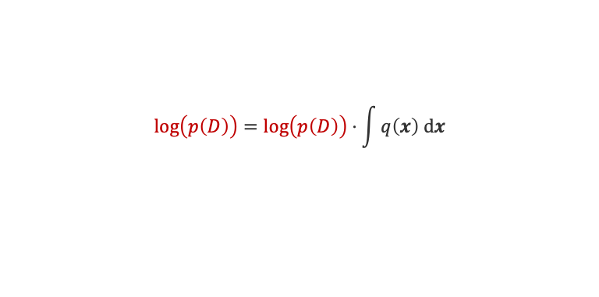






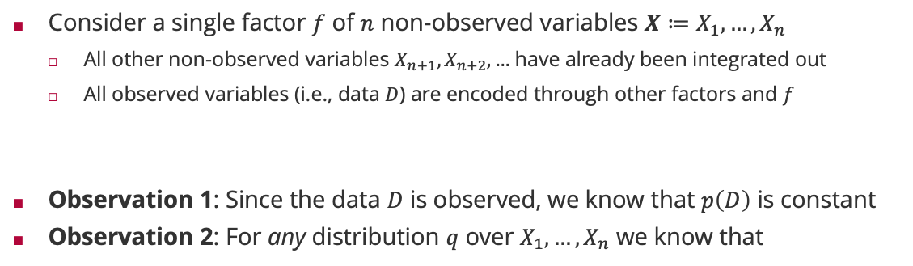


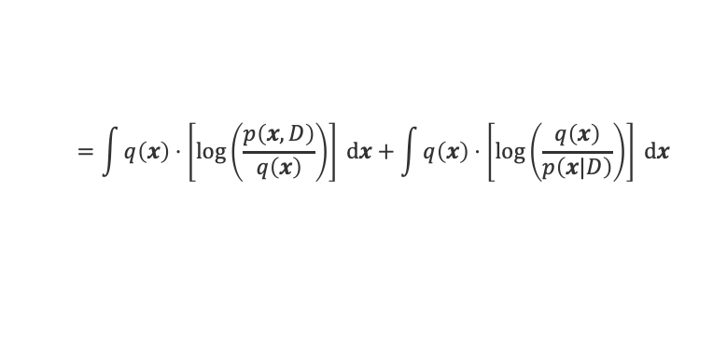
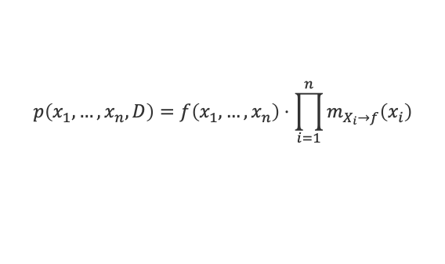

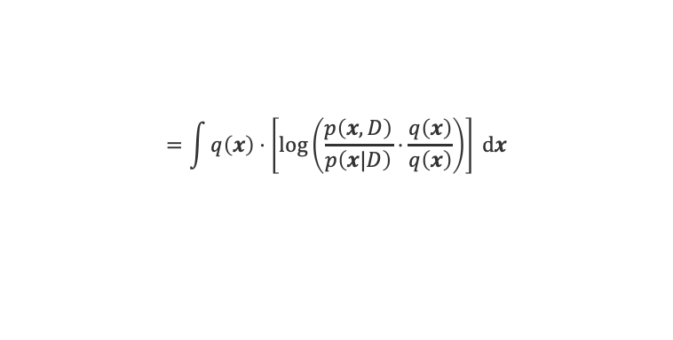


Evidence Lower Bound (ELBO)
Consider a single factor $f$ of $n$ non-observed variables $X≔X_{1},…,X_{n}$
All other non-observed variables $X_{n+1},X_{n+2},…$ have already been integrated out
All observed variables (i.e., data $D$) are encoded through other factors and $f$
Observation 1: Since the data $D$ is observed, we know that $p\left(D\right)$ is constant
Observation 2: For any distribution $q$ over $X_{1},…,X_{n}$ we know that
$$X_{1}$$
$$⋯$$
$$X_{n}$$
$$m_{X_{1}→f}\left(⋅\right)$$
$$m_{X_{n}→f}\left(⋅\right)$$
$$x$$
$$f\left(X_{1},…,X_{n}\right)$$
$$p\left(x_{1},…,x_{n},D\right)=f\left(x_{1},…,x_{n}\right)⋅\prod_{i=1}^{n}{m_{X_{i}→f}\left(x_{i}\right)}$$
$$=1$$
$$\log\left(p\left(D\right)\right)=\log\left(p\left(D\right)\right)⋅\int{q\left(x\right) dx}$$
$$p\left(x|D\right)=\frac{p\left(x,D\right)}{p\left(D\right)}$$
$$=1$$
$$=\int{q\left(x\right)⋅\left[\log\left(\frac{p\left(x,D\right)}{p\left(x|D\right)}⋅\frac{q\left(x\right)}{q\left(x\right)}\right)\right] dx}$$
$$=\int{q\left(x\right)⋅\left[\log\left(\frac{p\left(x,D\right)}{q\left(x\right)}\right)\right] dx}+\int{q\left(x\right)⋅\left[\log\left(\frac{q\left(x\right)}{p\left(x|D\right)}\right)\right] dx}$$
$$ELBO[q\left(⋅\right),p\left(⋅,D\right)]$$
$$KL\left[q\left(⋅\right),p\left(⋅|D\right)\right]≥0$$

Slide 9

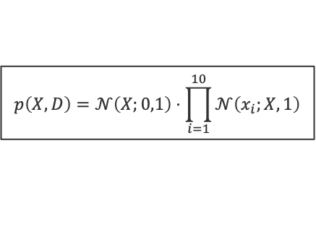





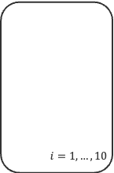



Evidence Lower Bound (ELBO): Example
$$KL\left[q\left(⋅\right),p\left(⋅|D\right)\right]=\log\left(p\left(D\right)\right)−ELBO\left[q\left(⋅\right),p\left(⋅,D\right)\right]$$
$$≥0$$
$$\log\left(p\left(D\right)\right)≥ELBO\left[q\left(⋅\right),p\left(⋅,D\right)\right]$$
$ELBO\left[q\left(⋅\right),p\left(⋅,D\right)\right]$ is a lower bound of the (constant) evidence $\log\left(p\left(D\right)\right)$
$$𝒩\left(X;0,1\right)$$
$$p\left(X,D\right)=𝒩\left(X;0,1\right)⋅\prod_{i=1}^{10}{𝒩\left(x_{i};X,1\right)}$$
$$i=1,…,10$$
$$X$$
$$q\left(⋅\right)=𝒩\left(⋅;\hat{μ},\frac{1}{11}\right)$$
$$q\left(⋅\right)=𝒩\left(⋅;\hat{μ},\frac{1}{100}\right)$$
$$q\left(⋅\right)=𝒩\left(⋅;\hat{μ},1\right)$$
$$𝒩\left(x_{i};X,1\right)$$
Maximizing $ELBO\left[q\left(⋅\right),p\left(⋅,D\right)\right]$ over $q\left(⋅\right)$ finds the minimizer of $KL\left[q\left(⋅\right),p\left(⋅|D\right)\right]$

Slide 10
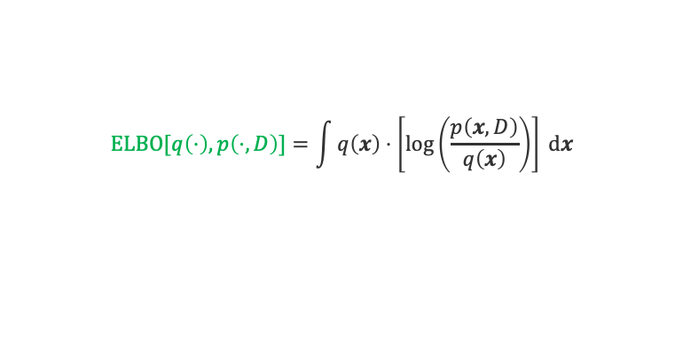

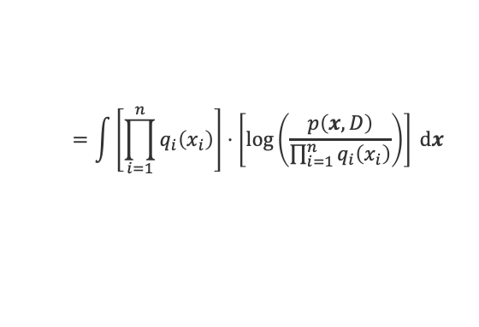


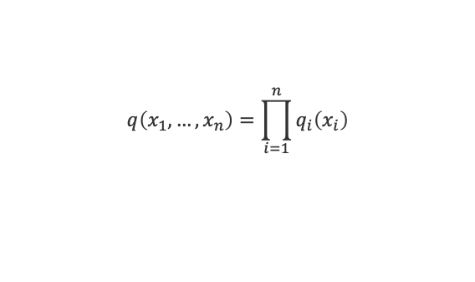

ELBO for Factorizing Distributions
Assumption: Since we are only interested in the marginals $p_{X_{i}}\left(⋅\right)$ we will assume
For our factor graph model, we have $q_{i}\left(x_{i}\right)∝m_{f→X_{i}}\left(x_{i}\right)⋅m_{X_{i}→f}\left(x_{i}\right)$
In this case the ELBO function becomes a sum of two terms
$$X_{1}$$
$$⋯$$
$$X_{n}$$
$$q\left(x_{1},…,x_{n}\right)=\prod_{i=1}^{n}{q_{i}\left(x_{i}\right)}$$
$$m_{X_{1}→f}\left(⋅\right)$$
$$m_{X_{n}→f}\left(⋅\right)$$
$$m_{f→X_{1}}\left(⋅\right)$$
$$m_{f→X_{n}}\left(⋅\right)$$
$$f\left(X_{1},…,X_{n}\right)$$
$$ELBO[q\left(⋅\right),p\left(⋅,D\right)]=\int{q\left(x\right)⋅\left[\log\left(\frac{p\left(x,D\right)}{q\left(x\right)}\right)\right] dx}$$
$$=\int{\left[\prod_{i=1}^{n}{q_{i}\left(x_{i}\right)}\right]⋅\left[\log\left(\frac{p\left(x,D\right)}{\prod_{i=1}^{n}{q_{i}\left(x_{i}\right)}}\right)\right] dx}$$
$$=\int{\left[\prod_{i=1}^{n}{q_{i}\left(x_{i}\right)}\right]⋅\log\left(p\left(x,D\right)\right) dx}−\sum_{i=1}^{n}{\int{q_{i}\left(x_{i}\right)⋅\log\left(q_{i}\left(x_{i}\right)\right) dx_{i}}}$$

Slide 11
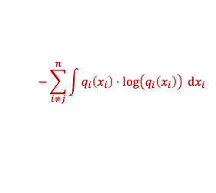
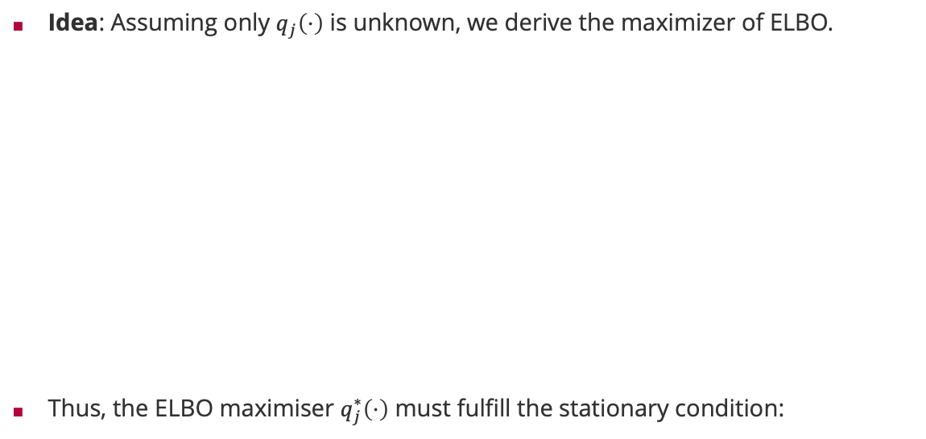
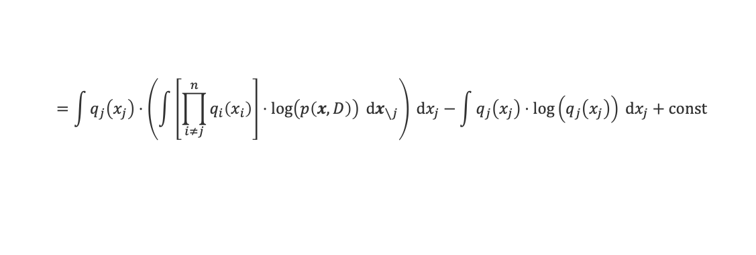

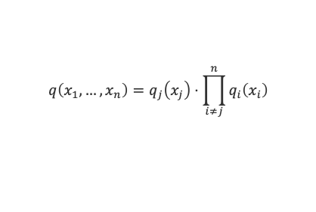

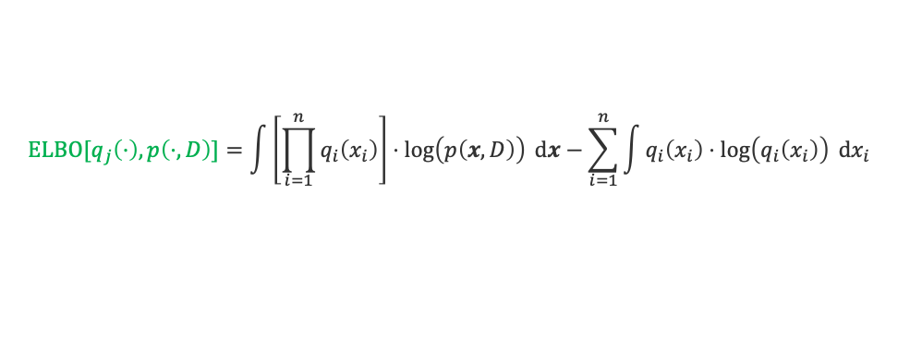
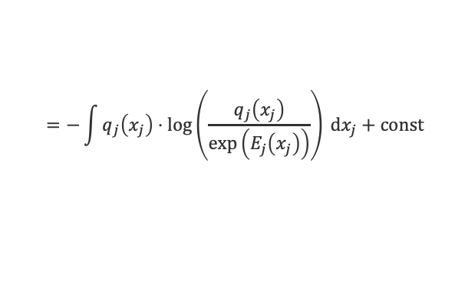


Maximizing ELBO for Factorizing Distributions
Idea: Assuming only $q_{j}\left(⋅\right)$ is unknown, we derive the maximizer of ELBO.
Thus, the ELBO maximiser $q_{j}^{∗}\left(⋅\right)$ must fulfill the stationary condition:
$$q\left(x_{1},…,x_{n}\right)=q_{j}\left(x_{j}\right)⋅\prod_{i≠j}^{n}{q_{i}\left(x_{i}\right)}$$
$$ELBO[q_{j}\left(⋅\right),p\left(⋅,D\right)]=\int{\left[\prod_{i=1}^{n}{q_{i}\left(x_{i}\right)}\right]⋅\log\left(p\left(x,D\right)\right) dx}−\sum_{i=1}^{n}{\int{q_{i}\left(x_{i}\right)⋅\log\left(q_{i}\left(x_{i}\right)\right) dx_{i}}}$$
$$=\int{q_{j}\left(x_{j}\right)⋅\left(\int{\left[\prod_{i≠j}^{n}{q_{i}\left(x_{i}\right)}\right]⋅\log\left(p\left(x,D\right)\right) dx_{∖j}}\right) dx_{j}}−\int{q_{j}\left(x_{j}\right)⋅\log\left(q_{j}\left(x_{j}\right)\right) dx_{j}}+const$$
const
$$−\sum_{i≠j}^{n}{\int{q_{i}\left(x_{i}\right)⋅\log\left(q_{i}\left(x_{i}\right)\right) dx_{i}}}$$
$$=−\int{q_{j}\left(x_{j}\right)⋅\log\left(\frac{q_{j}\left(x_{j}\right)}{\exp\left(E_{j}\left(x_{j}\right)\right)}\right) dx_{j}}+const$$
$E_{j}\left(x_{j}\right)$ where all $X_{i}$ with $i≠j$ are integrated out
$KL\left[q\left(⋅\right),\text{exp}\left(E_{j}\left(⋅\right)\right) \right]≥0$ with equality if and only if $q\left(⋅\right)∝\text{exp}\left(E_{j}\left(⋅\right)\right)$
$$q_{j}^{∗}\left(x_{j}\right)∝\exp\left(E_{j}\left(x_{j}\right)\right)$$
Note that the $E_{j}\left(⋅\right)$ requires all other $q_{i}\left(⋅\right)$ so these are $n$ coupled conditions for the ELBO maximiser!

Slide 12



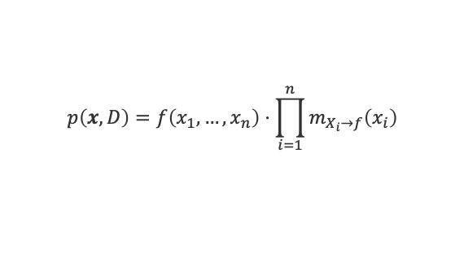
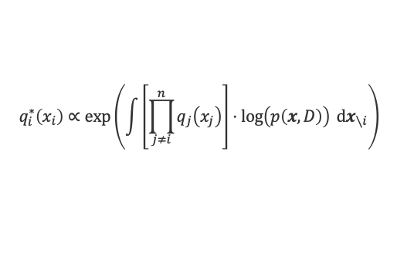

Variational Inference for Exponential Family
Consider a single factor $f$ of $n$ non-observed variables $X≔X_{1},…,X_{n}$
Assumption 1: All incoming messages from the variables $X_{i}$ are in the exponential family parameterized by the sufficient statistic $T_{i}\left(⋅\right)$
Assumption 2: The factor $f$ has the $n$ properties that for all $i=1,…,n$
Then, the variational approximation $q_{i}^{∗}\left(⋅\right)$ of the marginal $p_{X_{i}}\left(⋅\right)$ is
Dividing out $m_{X_{i}→f}\left(x_{i}\right)$, the variational approximation ${\hat{m}}_{f→X_{i}}\left(⋅\right)$ is given by
$$p\left(x,D\right)=f\left(x_{1},…,x_{n}\right)⋅\prod_{i=1}^{n}{m_{X_{i}→f}\left(x_{i}\right)}$$
$$X_{1}$$
$$⋯$$
$$X_{n}$$
$$m_{X_{1}→f}\left(⋅\right)$$
$$m_{X_{n}→f}\left(⋅\right)$$
$${\hat{m}}_{f→X_{1}}\left(⋅\right)$$
$${\hat{m}}_{f→X_{n}}\left(⋅\right)$$
$$f\left(X_{1},…,X_{n}\right)$$
$$m_{X_{i}→f}\left(x_{i}\right)∝\exp\left(θ_{i}^{T}T_{i}\left(x_{i}\right)\right)$$
$$q_{i}^{∗}\left(x_{i}\right)∝\exp\left(\int{\left[\prod_{j≠i}^{n}{q_{j}\left(x_{j}\right)}\right]⋅\log\left(p\left(x,D\right)\right) dx_{∖i}}\right)$$
$$f\left(x_{1},…,x_{n}\right)∝\exp\left(O_{i}{\left(x_{1},…,x_{i−1},x_{i+1},…,x_{n}\right)}^{T}T_{i}\left(x_{i}\right)\right)$$
$$q_{i}^{∗}\left(x_{i}\right)∝\exp\left(θ_{i}^{T}T_{i}\left(x_{i}\right)+E_{X_{1}∼q_{1}^{∗},…,X_{i−1}∼q_{i−1}^{∗},X_{i+1}∼q_{i+1}^{∗},…,X_{n}∼q_{n}^{∗}}{\left[O_{i}\left(X_{1},…,X_{i−1},X_{i+1},…,X_{n}\right)\right]}^{T}T_{i}\left(x_{i}\right)\right)$$
$${\hat{m}}_{f→X_{i}}\left(x_{i}\right)∝\exp\left(E_{X_{1}∼q_{1}^{∗},…,X_{i−1}∼q_{i−1}^{∗},X_{i+1}∼q_{i+1}^{∗},…,X_{n}∼q_{n}^{∗}}{\left[O_{i}\left(X_{1},…,X_{i−1},X_{i+1},…,X_{n}\right)\right]}^{T}T_{i}\left(x_{i}\right)\right)$$

Slide 13
Overview
Minimizing Reverse KL-Divergence via ELBO
Variational Inference for Gaussian Factors
Application: Robust Bayesian Regression and Ranking
Mixture Models

Slide 14







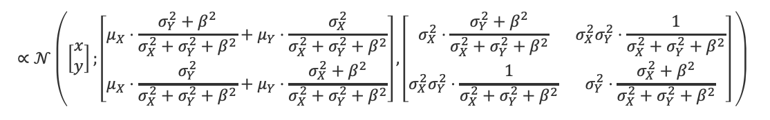

Gaussian Mean Factor: Joint Distribution
$$f\left(X,Y\right)=𝒩\left(Y;X,β^{2}\right)$$
$$𝒩\left(⋅;μ_{X},σ_{X}^{2}\right)$$
$$X$$
$$Y$$
The true joint distribution given this factor and the incoming messages is
Derived using the natural parameterization and collecting terms for $x$, $y$, $x^{2}$, $y^{2}$ and $x⋅y$
In the limit case of $β→∞$, the factor $𝒩\left(y;x,β^{2}\right)$ becomes the uniform-Normal and
$$𝒩\left(⋅;μ_{Y},σ_{Y}^{2}\right)$$
$$𝒩\left(Y;X,β^{2}\right)$$
$$p\left(x,y\right)=𝒩\left(x;μ_{X},σ_{X}^{2}\right)⋅𝒩\left(y;μ_{Y},σ_{Y}^{2}\right)⋅𝒩\left(y;x,β^{2}\right)$$
$$∝𝒩\left(\left[\begin{matrix}x \\ y\end{matrix}\right];\left[\begin{matrix}μ_{X}⋅\frac{σ_{Y}^{2}+β^{2}}{σ_{X}^{2}+σ_{Y}^{2}+β^{2}}+μ_{Y}⋅\frac{σ_{X}^{2}}{σ_{X}^{2}+σ_{Y}^{2}+β^{2}} \\ μ_{X}⋅\frac{σ_{Y}^{2}}{σ_{X}^{2}+σ_{Y}^{2}+β^{2}}+μ_{Y}⋅\frac{σ_{X}^{2}+β^{2}}{σ_{X}^{2}+σ_{Y}^{2}+β^{2}}\end{matrix}\right],\left[\begin{matrix}σ_{X}^{2}⋅\frac{σ_{Y}^{2}+β^{2}}{σ_{X}^{2}+σ_{Y}^{2}+β^{2}} & {σ_{X}^{2}σ}_{Y}^{2}⋅\frac{1}{σ_{X}^{2}+σ_{Y}^{2}+β^{2}} \\ {σ_{X}^{2}σ}_{Y}^{2}⋅\frac{1}{σ_{X}^{2}+σ_{Y}^{2}+β^{2}} & σ_{Y}^{2}⋅\frac{σ_{X}^{2}+β^{2}}{σ_{X}^{2}+σ_{Y}^{2}+β^{2}}\end{matrix}\right] \right)$$
Weighted average of the means with weights proportional to the variance ratios
Scaled (co)variances with weights proportional to the variance ratios
$$p\left(x,y\right)∝𝒩\left(\left[\begin{matrix}x \\ y\end{matrix}\right];\left[\begin{matrix}μ_{X} \\ μ_{Y}\end{matrix}\right],\left[\begin{matrix}σ_{X}^{2} & 0 \\ 0 & σ_{Y}^{2}\end{matrix}\right] \right)$$

Slide 15












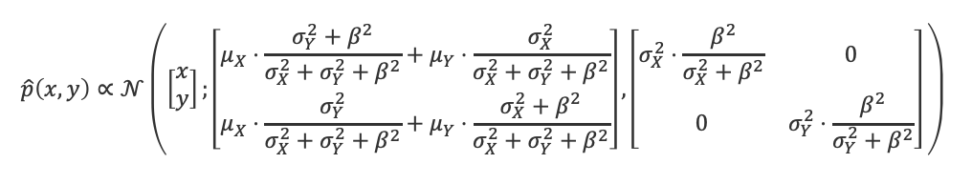



Gaussian Mean Factor: Variational Approximation
$$O_{X}\left(Y\right)$$
$$T_{X}\left(X\right)$$
$$f\left(X,Y\right)=𝒩\left(Y;X,β^{2}\right)$$
$$∝\exp\left({\left[\begin{matrix}β^{−2}Y \\ β^{−2}\end{matrix}\right]}^{T}\left[\begin{matrix}X \\ −\frac{X^{2}}{2}\end{matrix}\right]\right)$$
$$𝒩\left(⋅;μ_{X},σ_{X}^{2}\right)$$
$${\hat{m}}_{f→Y}\left(⋅\right)$$
$$=𝒢\left(Y;β^{−2}X,β^{−2}\right)$$
$$X$$
$$Y$$
$${\hat{m}}_{f→X}\left(⋅\right)$$
$$𝒩\left(⋅;μ_{Y},σ_{Y}^{2}\right)$$
$$O_{Y}\left(X\right)$$
$$T_{Y}\left(Y\right)$$
$$𝒩\left(Y;X,β^{2}\right)$$
$$∝\exp\left({\left[\begin{matrix}β^{−2}X \\ β^{−2}\end{matrix}\right]}^{T}\left[\begin{matrix}Y \\ −\frac{Y^{2}}{2}\end{matrix}\right]\right)$$
$$=𝒢\left(X;β^{−2}Y,β^{−2}\right)$$
$${\hat{p}}_{Y}\left(y\right)=𝒩\left(y;μ_{Y},σ_{Y}^{2}\right)⋅{\hat{m}}_{f→Y}\left(y\right)$$
$${\hat{m}}_{f→X}\left(x\right)∝\exp\left(E_{Y∼{\hat{p}}_{Y}}{\left[O_{X}\left(Y\right)\right]}^{T}T_{X}\left(x\right)\right)$$
$$∝𝒢\left(x;β^{−2}E_{Y∼{\hat{p}}_{Y}}\left[Y\right],β^{−2}\right)$$
$${\hat{m}}_{f→Y}\left(y\right)∝\exp\left(E_{X∼{\hat{p}}_{X}}{\left[O_{Y}\left(X\right)\right]}^{T}T_{Y}\left(y\right)\right)$$
$$∝𝒢\left(y;β^{−2}E_{X∼{\hat{p}}_{X}}\left[X\right],β^{−2}\right)$$
$${\hat{p}}_{X}\left(x\right)=𝒩\left(x;μ_{X},σ_{X}^{2}\right)⋅{\hat{m}}_{f→X}\left(x\right)$$
The two messages are coupled due to the expectation of $X$ and $Y$!
We can analytically solve these two equations for the joint solution to obtain
$$\hat{p}\left(x,y\right)∝𝒩\left(\left[\begin{matrix}x \\ y\end{matrix}\right];\left[\begin{matrix}μ_{X}⋅\frac{σ_{Y}^{2}+β^{2}}{σ_{X}^{2}+σ_{Y}^{2}+β^{2}}+μ_{Y}⋅\frac{σ_{X}^{2}}{σ_{X}^{2}+σ_{Y}^{2}+β^{2}} \\ μ_{X}⋅\frac{σ_{Y}^{2}}{σ_{X}^{2}+σ_{Y}^{2}+β^{2}}+μ_{Y}⋅\frac{σ_{X}^{2}+β^{2}}{σ_{X}^{2}+σ_{Y}^{2}+β^{2}}\end{matrix}\right],\left[\begin{matrix}σ_{X}^{2}⋅\frac{β^{2}}{σ_{X}^{2}+β^{2}} & 0 \\ 0 & σ_{Y}^{2}⋅\frac{β^{2}}{σ_{Y}^{2}+β^{2}}\end{matrix}\right] \right)$$
Smaller than the true variance of $σ_{X}^{2}⋅\frac{σ_{Y}^{2}+β^{2}}{σ_{X}^{2}+σ_{Y}^{2}+β^{2}}$

Slide 16






Gaussian Mean Factor: Examples
$$m_{X→f}\left(x\right)=𝒩\left(x;0,1\right)$$
$$𝒩\left(⋅;μ_{X},σ_{X}^{2}\right)$$
$${\hat{m}}_{f→Y}\left(⋅\right)$$
$$m_{Y→f}\left(y\right)=𝒩\left(y;0,1\right)$$
$$X$$
$$Y$$
$${\hat{m}}_{f→X}\left(⋅\right)$$
$$𝒩\left(⋅;μ_{Y},σ_{Y}^{2}\right)$$
$$f(x,y)=𝒩\left(y;x,β^{2}\right)$$
$$𝒩\left(Y;X,β^{2}\right)$$
$$β=0.5$$
$$β=1$$
$$β=2$$

Slide 17







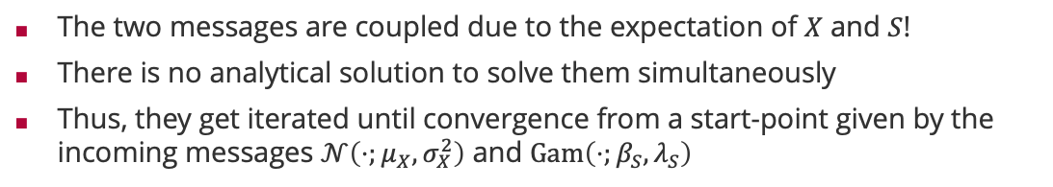











Gaussian Factor with Variable Precision
$$f\left(X,S\right)=𝒩\left(X;μ,S^{−1}\right)$$
$$𝒩\left(⋅;μ_{X},σ_{X}^{2}\right)$$
$${\hat{m}}_{f→S}\left(⋅\right)$$
$$=\exp\left(\frac{1}{2}\log\left(S\right)−\frac{1}{2}\log\left(2π\right)−\frac{S⋅{\left(X−μ\right)}^{2}}{2}\right)$$
$$X$$
$$S$$
$${\hat{m}}_{f→X}\left(⋅\right)$$
$$𝒩\left(X;μ,S^{−1}\right)$$
$$Gam\left(⋅;β_{S},λ_{S}\right)$$
$$O_{X}\left(S\right)$$
$$T_{X}\left(X\right)$$
$$∝\exp\left({\left[\begin{matrix}S⋅μ \\ S\end{matrix}\right]}^{T}\left[\begin{matrix}X \\ −\frac{X^{2}}{2}\end{matrix}\right]\right)$$
$${\hat{m}}_{f→X}\left(x\right)∝\exp\left(E_{S∼{\hat{p}}_{S}}{\left[O_{X}\left(S\right)\right]}^{T}T_{X}\left(x\right)\right)$$
$$∝𝒢\left(x;μ⋅E_{S∼{\hat{p}}_{S}}\left[S\right],E_{S∼{\hat{p}}_{S}}\left[S\right]\right)$$
$$∝\exp\left({\left[\begin{matrix}\frac{1}{2} \\ \frac{{\left(X−μ\right)}^{2}}{2}\end{matrix}\right]}^{T}\left[\begin{matrix}\log{(S)} \\ −S\end{matrix}\right]\right)$$
$${\hat{p}}_{S}\left(s\right)=Gam\left(s;β_{S},λ_{S}\right)⋅{\hat{m}}_{f→S}\left(s\right)$$
$$O_{S}\left(X\right)$$
$$T_{S}\left(S\right)$$
$${\hat{p}}_{X}\left(x\right)=𝒩\left(x;μ_{X},σ_{X}^{2}\right)⋅{\hat{m}}_{f→X}\left(x\right)$$
$${\hat{m}}_{f→S}\left(s\right)∝\exp\left(E_{X∼{\hat{p}}_{X}}{\left[O_{S}\left(X\right)\right]}^{T}T_{S}\left(s\right)\right)$$
$$∝Gam\left(s;\frac{1}{2}, \frac{E_{X∼{\hat{p}}_{X}}\left[X^{2}\right]+μ^{2}}{2}−μ⋅E_{X∼{\hat{p}}_{X}}\left[X\right]\right)$$
The two messages are coupled due to the expectation of $X$ and $S$!
There is no analytical solution to solve them simultaneously
Thus, they get iterated until convergence from a start-point given by the incoming messages $𝒩\left(⋅;μ_{X},σ_{X}^{2}\right)$ and $Gam\left(⋅;β_{S},λ_{S}\right)$

Slide 18
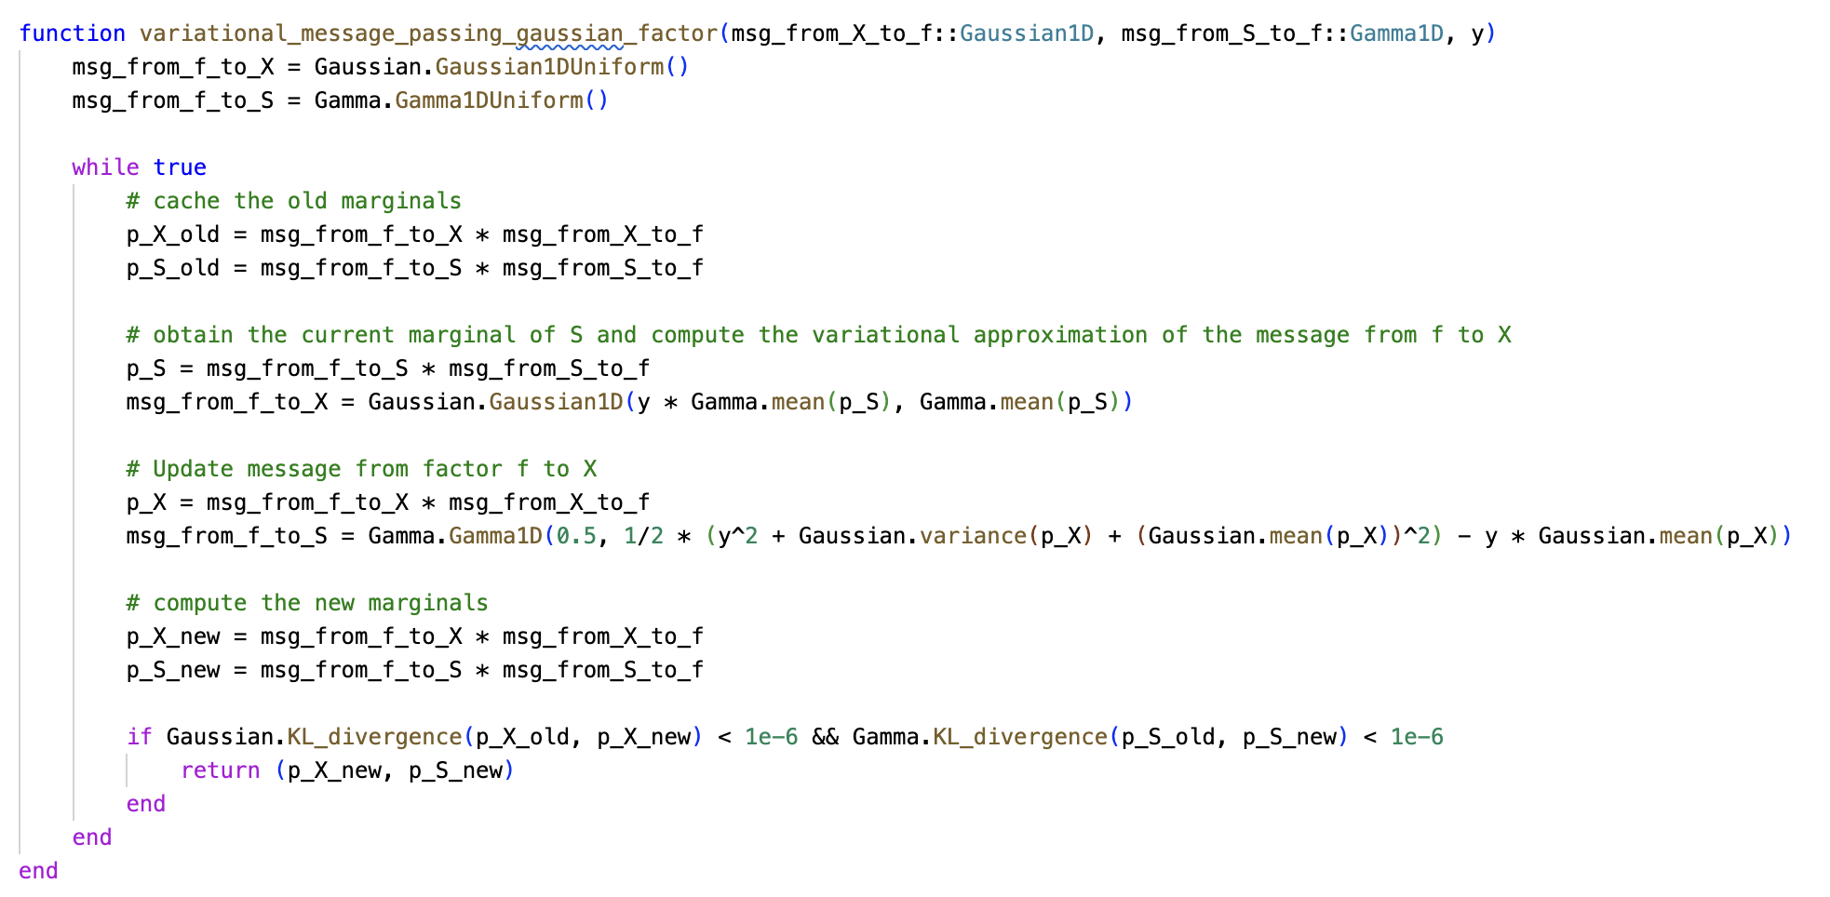




Gaussian Factor with Variable Precision: Examples
$$m_{X→f}\left(x\right)=𝒩\left(x;0,1\right)$$
$$𝒩\left(⋅;μ_{X},σ_{X}^{2}\right)$$
$${\hat{m}}_{f→S}\left(⋅\right)$$
$$X$$
$$S$$
$$m_{S→f}\left(s\right)=Gam\left(s;3,0.5\right)$$
$${\hat{m}}_{f→X}\left(⋅\right)$$
$$𝒩\left(X;y,S^{−1}\right)$$
$$Gam\left(⋅;β_{S},λ_{S}\right)$$
$$f(x,s)=𝒩\left(x;2,s^{−1}\right)$$
Start
Iteration 1
Iteration 2

Slide 19














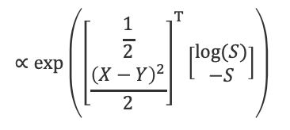















Gaussian Mean Factor with Variable Precision
$$S$$
$$=\exp\left(\frac{1}{2}\log\left(S\right)−\frac{1}{2}\log\left(2π\right)−\frac{S⋅{\left(X−Y\right)}^{2}}{2}\right)$$
$$f\left(X,Y,S\right)=𝒩\left(X;Y,S^{−1}\right)$$
$$Gam\left(⋅;β_{S},λ_{S}\right)$$
$${\hat{m}}_{f→S}\left(⋅\right)$$
$$𝒩\left(⋅;μ_{X},σ_{X}^{2}\right)$$
$${\hat{m}}_{f→Y}\left(⋅\right)$$
$$O_{X}\left(S,Y\right)$$
$$T_{X}\left(X\right)$$
$${\hat{m}}_{f→X}\left(x\right)∝\exp\left(E_{Y∼{\hat{p}}_{Y},S∼{\hat{p}}_{S}}{\left[O_{X}\left(S,Y\right)\right]}^{T}T_{X}\left(x\right)\right)$$
$$X$$
$$Y$$
$$∝\exp\left({\left[\begin{matrix}S⋅Y \\ S\end{matrix}\right]}^{T}\left[\begin{matrix}X \\ −\frac{X^{2}}{2}\end{matrix}\right]\right)$$
$$𝒩\left(X;Y,S^{−1}\right)$$
$$∝𝒢\left(x;E_{Y∼{\hat{p}}_{Y}}\left[Y\right]⋅E_{S∼{\hat{p}}_{S}}\left[S\right],E_{S∼{\hat{p}}_{S}}\left[S\right]\right)$$
$${\hat{m}}_{f→X}\left(⋅\right)$$
$$𝒩\left(⋅;μ_{Y},σ_{Y}^{2}\right)$$
$$O_{Y}\left(S,X\right)$$
$$T_{Y}\left(Y\right)$$
$${\hat{p}}_{S}\left(s\right)=Gam\left(s;β_{S},λ_{S}\right)⋅{\hat{m}}_{f→S}\left(s\right)$$
$$∝\exp\left({\left[\begin{matrix}S⋅X \\ S\end{matrix}\right]}^{T}\left[\begin{matrix}Y \\ −\frac{Y^{2}}{2}\end{matrix}\right]\right)$$
$${\hat{m}}_{f→Y}\left(y\right)∝\exp\left(E_{X∼{\hat{p}}_{X},S∼{\hat{p}}_{S}}{\left[O_{Y}\left(S,X\right)\right]}^{T}T_{Y}\left(y\right)\right)$$
$$∝𝒢\left(y;E_{X∼{\hat{p}}_{X}}\left[X\right]⋅E_{S∼{\hat{p}}_{S}}\left[S\right],E_{S∼{\hat{p}}_{S}}\left[S\right]\right)$$
$${\hat{p}}_{Y}\left(y\right)=𝒩\left(y;μ_{Y},σ_{Y}^{2}\right)⋅{\hat{m}}_{f→Y}\left(y\right)$$
$$∝\exp\left({\left[\begin{matrix}\frac{1}{2} \\ \frac{{\left(X−Y\right)}^{2}}{2}\end{matrix}\right]}^{T}\left[\begin{matrix}\log{(S)} \\ −S\end{matrix}\right]\right)$$
$${\hat{p}}_{X}\left(x\right)=𝒩\left(x;μ_{X},σ_{X}^{2}\right)⋅{\hat{m}}_{f→X}\left(x\right)$$
$$O_{S}\left(X,Y\right)$$
$$T_{S}\left(S\right)$$
$${\hat{m}}_{f→S}\left(s\right)∝\exp\left(E_{X∼{\hat{p}}_{X},Y∼{\hat{p}}_{Y}}{\left[O_{S}\left(X,Y\right)\right]}^{T}T_{S}\left(s\right)\right)$$
$$∝Gam\left(s;\frac{1}{2}, \frac{E_{X∼{\hat{p}}_{X}}\left[X^{2}\right]+E_{Y∼{\hat{p}}_{Y}}\left[Y^{2}\right]}{2}−E_{Y∼{\hat{p}}_{Y}}\left[Y\right]⋅E_{X∼{\hat{p}}_{X}}\left[X\right]\right)$$
The three messages (six equations) are coupled due to the expectation of $X$, $Y$ and $S$
Iterate to solve for the six parameters of the messages ${\hat{m}}_{f→X}\left(⋅\right)$, ${\hat{m}}_{f→Y}\left(⋅\right)$ and ${\hat{m}}_{f→S}\left(⋅\right)$

Slide 20







Gaussian Factor with Variable Precision: Examples
$$S$$
$$m_{X→f}\left(x\right)=𝒩\left(x;0,1\right)$$
$$Gam\left(⋅;β_{S},λ_{S}\right)$$
$${\hat{m}}_{f→S}\left(⋅\right)$$
$$m_{Y→f}\left(y\right)=𝒩\left(y;2,0.5\right)$$
$$𝒩\left(⋅;μ_{X},σ_{X}^{2}\right)$$
$${\hat{m}}_{f→Y}\left(⋅\right)$$
$$m_{S→f}\left(s\right)=Gam\left(s;2,1\right)$$
$$X$$
$$Y$$
$$f(x,y,s)=𝒩\left(x;y,s^{−1}\right)$$
$${\hat{m}}_{f→X}\left(⋅\right)$$
$$𝒩\left(X;Y,S^{−1}\right)$$
$$𝒩\left(⋅;μ_{Y},σ_{Y}^{2}\right)$$
Marginal $p_{XY}$
Marginal $p_{XS}$
Marginal $p_{YS}$

Slide 21
Overview
Minimizing Reverse KL-Divergence via ELBO
Variational Inference for Gaussian Factors
Application: Robust Bayesian Regression and Ranking
Mixture Models

Slide 22


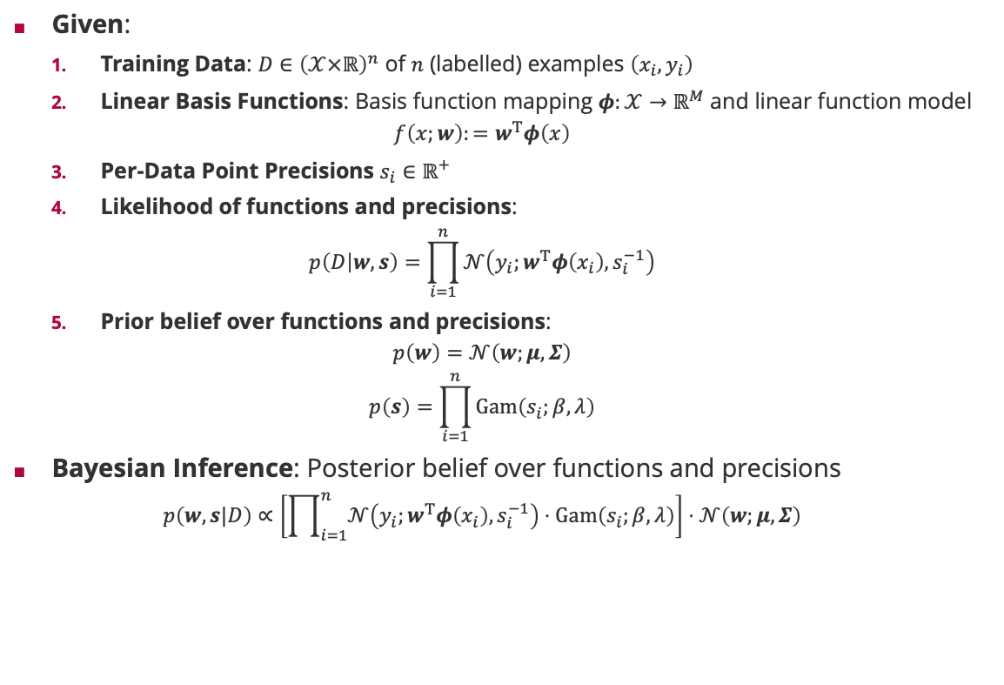











Robust Bayesian Regression
Given:
Training Data: $D∈{\left(𝒳×ℝ\right)}^{n}$ of $n$ (labelled) examples $\left(x_{i},y_{i}\right)$
Linear Basis Functions: Basis function mapping $φ:𝒳→ℝ^{M}$ and linear function model
$$f\left(x;w\right):=w^{T}φ\left(x\right)$$
Per-Data Point Precisions $s_{i}∈ℝ^{+}$
Likelihood of functions and precisions:
$$p\left(D | w,s\right)=\prod_{i=1}^{n}{𝒩\left(y_{i};w^{T}φ\left(x_{i}\right),s_{i}^{−1}\right)}$$
Prior belief over functions and precisions:
$$p\left(w\right)=𝒩\left(w;μ,Σ\right)$$
$$p\left(s\right)=\prod_{i=1}^{n}{Gam\left(s_{i};β,λ\right)}$$
Bayesian Inference: Posterior belief over functions and precisions
$$p\left(w,s|D\right)∝\left[\prod_{i=1}^{n}{𝒩\left(y_{i};w^{T}φ\left(x_{i}\right),s_{i}^{−1}\right)⋅Gam\left(s_{i};β,λ\right)}\right]⋅𝒩\left(w;μ,Σ\right)$$
Factor Graph
$$𝒩\left(W;μ,Σ\right)$$
$$W$$
$$i=1,…,n$$
Bayesian Network
$$δ\left(T_{i}−W^{T}φ\left(x_{i}\right) \right)$$
$$W$$
$$T_{i}$$
$$i=1,…,n$$
$$𝒩\left(y_{i};T_{i},S_{i}^{−1} \right)$$
$X_{i}$
$$Y_{i}$$
$$S_{i}$$
$$S_{i}$$
$$Gam\left(S_{i};β,λ \right)$$

Slide 23














Robust Bayesian Regression: Warm-Up
Simple Model: We have no features so $W$ is a single number $T$ (the average of the observations $y_{i}$)
Message Schedule:
Send exact prior messages to $T$ and all $S_{i}$
For each observation $y_{i}$, update variational message to $S_{i}$
For each observation $y_{i}$, update variational message to $T$
Factor Graph
$$𝒩\left(T;μ,σ^{2} \right)$$
Bayesian Network
1
$$T$$
$$T$$
$$i=1,…,n$$
$$i=1,…,n$$
3
$$Y_{i}$$
$$𝒩\left(T_{i};y_{i},S_{i}^{−1} \right)$$
2
Fixed noise ($β^{2}=0.01$)
Variable noise
$$S_{i}$$
$$S_{i}$$
1
$$Gam\left(S_{i};β,λ \right)$$
$$n=1000$$
$$μ=0$$
$$σ^{2}=1$$
$$β=0$$
$$λ=1$$

Slide 24






Robust Bayesian Regression
Message Schedule:
Send exact prior messages to $W$ and all $S_{i}$
Outer loop iterating over the observations $\left(x_{i},y_{i}\right)$:
Send the message from the projection factor to $T_{i}$
Iterate the variational messages from the Gaussian factor to $S_{i}$ and $T_{i}$
Send the message from the projection factor to $W$
Factor Graph
$$𝒩\left(W;μ,Σ\right)$$
1
$$W$$
4
$$i=1,…,n$$
$$δ\left(T_{i}−W^{T}φ\left(x_{i}\right) \right)$$
2
$$T_{i}$$
3
Outliers
$$𝒩\left(y_{i};T_{i},S_{i}^{−1} \right)$$
$$μ=0$$
3
$$S_{i}$$
$$Σ=I$$
1
$$Gam\left(S_{i};β,λ \right)$$
$$φ\left(x\right)=\left[\begin{matrix}𝒩\left(x;{0,0.2}^{2}\right) \\ ⋮ \\ 𝒩\left(x;{1,0.2}^{2}\right)\end{matrix}\right]$$
$$β=0.5$$
$$λ=1$$
$$n=40$$

Slide 25
























Robust Bayesian Ranking
Bayesian Network
Factor Graph
Classic:
Two players have unknown skills $S_{1}$ and $S_{2}$ with Gaussian belief
Performance $P_{i}$ in a match is Gaussian with mean $S_{i}$
Match-outcome $y∈\left\{−1,+1\right\}$ means that $y⋅\left(P_{1}−P_{2}\right)>0$
Robust:
We assume an unknown performance variation $B_{i}$ with Gamma distribution
Performance $P_{i}$ in a match is Gaussian with mean $S_{i}$ and variance $B_{i}^{−1}$
The rest is the same!
$$𝒩\left(S_{1};μ_{1},σ_{1}^{2}\right)$$
$$𝒩\left(S_{2};μ_{2},σ_{2}^{2}\right)$$
$$S_{1}$$
$$S_{2}$$
1
1
$$S_{1}$$
$$S_{2}$$
$$B_{1}$$
$$P_{1}$$
$$P_{2}$$
$$B_{2}$$
$$Gam\left(B_{1};β,λ \right)$$
6
7
7
6
$$Gam\left(B_{2};β,λ \right)$$
$$B_{1}$$
$$𝒩\left(P_{1};S_{1},B_{1}^{−1}\right)$$
$$𝒩\left(P_{2};S_{2},B_{2}^{−1}\right)$$
$$B_{2}$$
2
2
$$D$$
1
$$P_{1}$$
$$P_{2}$$
1
5
5
$$Y$$
$$δ\left(D−\left(P_{1}−P_{2}\right)\right)$$
3
$$D$$
4
$$𝕀\left(y⋅D>0\right)$$

Slide 26

Robust Bayesian Ranking: Example
Variable performance precision model can disregard extreme match outcomes and models the full skill range
Experimental Setup:
We have $50$ players with skills evenly distributed in $\left[−3,3\right]$
The prior of the performance precision is $B_{i}∼Gam\left(0,1\right)$
We generate 10,000 matches with random player indices and outcomes using random performance precisions
We ran TrueSkill Through Time both with fixed (blue) and variable (red) performance precision
Variable performance precision model gets more certain skill estimates from the same data

Slide 27



















Robust Ranking: Modelling Performance Precisions
Per-Match Precisions:
Number of skills variables equals number $P$ of players
Number of performance precisions equals number $G$ of games
Per-Player Precisions:
Number of skills variables equals number $P$ of players
Number of performance precisions equals number $P$ of players!
Pro: Per-player precisions model a property of players
Con: Loopy graph leads to over-confidence
Per-Match Performance Precisions
Per-Player Performance Precisions
$$j=1,…,P$$
$$j=1,…,P$$
$$j=1,…,P$$
$$S_{j}$$
$$S_{j}$$
$$B_{j}$$
$$i=1,…,G$$
$$i=1,…,G$$
$$B_{1,i}$$
$$P_{1,i}$$
$$P_{2,i}$$
$$B_{2,i}$$
$$P_{1,i}$$
$$P_{2,i}$$
$$D_{i}$$
$$D_{i}$$
$$Y_{i}$$
$$Y_{i}$$

Slide 28


Robust Bayesian Ranking: Per-Player Precision Example
Model infers the correct small performance precision
Belief distribution over the performance precisions converges to true value
$$G=10,000$$
$$G=100,000$$

Slide 29
Overview
Minimizing Reverse KL-Divergence via ELBO
Variational Inference for Gaussian Factors
Application: Robust Bayesian Regression and Ranking
Mixture Models

Slide 30

















From Selection Models to Mixture Models
Selection Model
Selection Model: If we have $K$ possible Gaussian causes $X_{1},…,X_{K}$ for an observed effect $Y$ and a categorical selector $Z∈{\left\{0,1\right\}}^{K}$ then
Challenge: What is the marginal distribution if we marginalize out the $X_{k}$?
$$Z$$
explicit selector
$$𝒩\left(X_{1};μ_{1},σ_{1}^{2}\right)$$
$$X_{1}$$
$$f\left(X_{1},…,X_{K},Z,Y\right)=\sum_{k=1}^{K}{Z_{k}}⋅δ\left(Y−X_{k}\right)$$
$$⋮$$
$$Y$$
$$\sum_{k=1}^{K}{Z_{k}}⋅δ\left(Y−X_{k}\right)$$
$$𝒩\left(X_{K};μ_{K},σ_{K}^{2}\right)$$
$$X_{K}$$
$$g\left(Z,Y\right)=\int{⋯\int{\left[\prod_{k=1}^{K}{m_{X_{k}→f}\left(X_{k}\right)}\right]⋅f\left(X_{1},…,X_{K},Z,Y\right) dX_{1}⋯dX_{K}}}$$
Mixture Model
$$Z$$
$$=\int{⋯\int{\left[\prod_{k=1}^{K}{𝒩\left(X_{k};μ_{k},σ_{k}^{2}\right)}\right]⋅\left[\sum_{k=1}^{K}{Z_{k}}⋅δ\left(Y−X_{k}\right)\right]dX_{1}⋯dX_{K}}}$$
$$Y$$
$$=\sum_{k=1}^{K}{Z_{k}}⋅\int{𝒩\left(X_{k};μ_{k},σ_{k}^{2}\right)⋅δ\left(Y−X_{k}\right) dX_{k}}$$
$$\sum_{k=1}^{K}{Z_{k}}⋅𝒩\left(Y;μ_{k},σ_{k}^{2}\right)$$
$$=\sum_{k=1}^{K}{Z_{k}}⋅𝒩\left(Y;μ_{k},σ_{k}^{2}\right)$$

Slide 31





















Mixture of Gaussians Model
Bayesian Network
Factor Graph
Model:
We assume that there are $K$ Normal distributions with unknown mean $M_{k}$ and precisions $S_{k}$ that generate the data $x_{i}∈ℝ$
We assume that each Normal distribution is selected for generating the data with unknown probability $P_{k}$
For each data item, we sample the index $j$ with probability $P_{j}$ and then sample $x_{i}$ from $𝒩\left(⋅;M_{j},S_{j}^{−1}\right)$
We have a Dirichlet prior on $P$, a Gamma prior on each $S_{k}$ and a Normal prior on each $M_{k}$
$$P$$
$$Dir\left(P;α \right)$$
$$i=1,…,n$$
$$P$$
$$Z_{i}$$
$$i=1,…,n$$
$$Cat\left(Z_{i};P \right)$$
$$k=1,…,K$$
$$k=1,…,K$$
$$Z_{i}$$
$$S_{k}$$
$$X_{i}$$
$$M_{k}$$
$$k=1,…,K$$
$$k=1,…,K$$
$$S_{k}$$
$$\sum_{k=1}^{K}{Z_{i,k}}⋅𝒩\left(x_{i};M_{k},S_{k}^{−1}\right)$$
$$M_{k}$$
$$Gam\left(S_{k};β_{k},λ_{k} \right)$$
$$𝒩\left(M_{k};μ_{k},σ_{k}^{2}\right)$$
We do not know the approximate messages for these two types of factors yet!

Slide 32
























Dirichlet-Categorical Factor
$$f\left(Z,P\right)=Cat\left(Z;P\right)$$
$$=\prod_{k=1}^{K}{P_{k}^{Z_{k}}}$$
$$Dir\left(⋅;a \right)$$
$${\hat{m}}_{f→Z}\left(⋅\right)$$
$$=\exp\left(\sum_{k=1}^{K}{Z_{k}⋅\log\left(P_{k}\right)}\right)$$
$$P$$
$$Z$$
$${\hat{m}}_{f→P}\left(⋅\right)$$
$$Cat\left(Z;P \right)$$
$$𝒞\left(⋅;η \right)$$
$$O_{P}\left(Z\right)$$
$$T_{P}\left(P\right)$$
$$∝\exp\left({\left[\begin{matrix}Z_{1} \\ ⋮ \\ Z_{K}\end{matrix}\right]}^{T}\left[\begin{matrix}\log\left(P_{1}\right) \\ ⋮ \\ \log\left(P_{K}\right)\end{matrix}\right]\right)$$
$${\hat{m}}_{f→P}\left(p\right)∝\exp\left(E_{Z∼{\hat{p}}_{Z}}{\left[O_{P}\left(Z\right)\right]}^{T}T_{P}\left(p\right)\right)$$
$$∝Dir\left(p;E_{Z∼{\hat{p}}_{Z}}\left[Z\right]+1\right)$$
$$∝\exp\left({\left[\begin{matrix}\log\left(P_{1}\right) \\ ⋮ \\ \log\left(P_{K}\right)\end{matrix}\right]}^{T}\left[\begin{matrix}Z_{1} \\ ⋮ \\ Z_{K}\end{matrix}\right]\right)$$
$${\hat{p}}_{Z}\left(z\right)=𝒞\left(z;η\right)⋅{\hat{m}}_{f→Z}\left(z\right)$$
$$O_{Z}\left(P\right)$$
$$T_{Z}\left(Z\right)$$
$${\hat{p}}_{P}\left(p\right)=Dir\left(p;a \right)⋅{\hat{m}}_{f→P}\left(p\right)$$
$${\hat{m}}_{f→Z}\left(z\right)∝\exp\left(E_{P∼{\hat{p}}_{P}}{\left[O_{Z}\left(P\right)\right]}^{T}T_{Z}\left(z\right)\right)$$
$$∝𝒞\left(z;E_{P∼{\hat{p}}_{P}}\left[\begin{matrix}\log\left(P_{1}\right) \\ ⋮ \\ \log\left(P_{K}\right)\end{matrix}\right]\right)$$
If $P∼Dir\left(⋅;α\right)$ then $$E\left[\log\left(P_{i}\right)\right]=ψ\left(α_{i}\right)−ψ\left(α^{T}1\right)$$
The two messages are coupled due to the expectation of $P$ and $Z$!
There is no analytical solution to solve them simultaneously
Thus, they get iterated until convergence from a start-point given by the incoming messages $Dir\left(⋅;a \right)$ and $𝒞\left(⋅;η \right)$

Slide 33































Mixture Factor for 1D Gaussians
$$Z$$
$$f\left(Z,M,S\right)=\prod_{k=1}^{K}{{\left[𝒩\left(x;M_{k},S_{k}^{−1}\right)\right]}^{Z_{k}}}$$
$$=\exp\left(\sum_{k=1}^{K}{Z_{k}⋅\frac{1}{2}\left[\log\left(S_{k}\right)−\log\left(2π\right)−S_{k}⋅{\left(x−M_{k}\right)}^{2}\right]}\right)$$
$$Cat\left(⋅;p \right)$$
$${\hat{m}}_{f→Z}\left(⋅\right)$$
$$O_{S_{k}}\left(Z,M\right)$$
$$T_{S_{k}}\left(S_{k}\right)$$
$$k=1,…,K$$
$$Gam\left(⋅;β_{k},λ_{k}\right)$$
$${\hat{m}}_{f→M_{k}}\left(⋅\right)$$
$$k=1,…,K$$
$$∝\exp\left({\frac{1}{2}⋅\left[\begin{matrix}Z_{k} \\ {Z_{k}\left(x−M_{k}\right)}^{2}\end{matrix}\right]}^{T}\left[\begin{matrix}\log\left(S_{k}\right) \\ −S_{k}\end{matrix}\right]\right)$$
$${\hat{m}}_{f→S_{k}}\left(s_{k}\right)∝\exp\left(E_{Z∼{\hat{p}}_{Z},M∼{\hat{p}}_{M}}{\left[O_{S_{k}}\left(Z,M\right)\right]}^{T}T_{S_{k}}\left(s_{k}\right)\right)$$
$$S_{k}$$
$$M_{k}$$
$${\hat{m}}_{f→S_{k}}\left(⋅\right)$$
$$f\left(Z,M,S\right)$$
$$𝒩\left(⋅;μ_{k},σ_{k}^{2}\right)$$
$$∝Gam\left(s_{k};\frac{E\left[Z_{k}\right]}{2},\frac{E\left[Z_{k}\right]⋅\left[x^{2}−2x⋅E\left[M_{k}\right]+E\left[M_{k}^{2}\right]\right]}{2}\right)$$
$$O_{M_{k}}\left(Z,S\right)$$
$$∝\exp\left({\left[\begin{matrix}x⋅Z_{k}⋅S_{k} \\ Z_{k}⋅S_{k}\end{matrix}\right]}^{T}\left[\begin{matrix}M_{k} \\ −\frac{M_{k}^{2}}{2}\end{matrix}\right]\right)$$
$$T_{M_{k}}\left(M_{k}\right)$$
$${\hat{p}}_{Z}\left(z\right)=Cat\left(z;p \right)⋅{\hat{m}}_{f→Z}\left(z\right)$$
$${\hat{m}}_{f→M_{k}}\left(m_{k}\right)∝\exp\left(E_{Z∼{\hat{p}}_{Z},S∼{\hat{p}}_{S}}{\left[O_{M_{k}}\left(Z,S\right)\right]}^{T}T_{M_{k}}\left(m_{k}\right)\right)$$
$${\hat{p}}_{M}\left(m\right)=\prod_{k=1}^{K}{𝒩\left(m_{k};μ_{k},σ_{k}^{2}\right)⋅{\hat{m}}_{f→M_{k}}\left(m_{k}\right)}$$
$$O_{Z}\left(S,M\right)$$
$$T_{Z}\left(Z\right)$$
$$∝𝒢\left(m_{k};x⋅E\left[Z_{k}\right]⋅E\left[S_{k}\right],E\left[Z_{k}\right]⋅E\left[S_{k}\right]\right)$$
$${\hat{p}}_{S}\left(s\right)=\prod_{k=1}^{K}{Gam\left(s_{k};β_{k},λ_{k}\right)⋅{\hat{m}}_{f→S_{k}}\left(s_{k}\right)}$$
$$∝\exp\left(\frac{1}{2}⋅{\left[\begin{matrix}\log\left(S_{1}\right)−S_{1}⋅{\left(x−M_{1}\right)}^{2} \\ ⋮ \\ \log\left(S_{K}\right)−S_{K}⋅{\left(x−M_{K}\right)}^{2}\end{matrix}\right]}^{T}\left[\begin{matrix}Z_{1} \\ ⋮ \\ Z_{K}\end{matrix}\right]\right)$$
$${\hat{m}}_{f→Z}\left(z\right)∝\exp\left(E_{M∼{\hat{p}}_{M},S∼{\hat{p}}_{S}}{\left[O_{Z}\left(S,M\right)\right]}^{T}T_{Z}\left(z\right)\right)$$
$$∝𝒞\left(z;\left[\begin{matrix}E\left[\log\left(S_{1}\right)\right]−E\left[S_{1}\right]⋅{\left(x^{2}−2x⋅E\left[M_{1}\right]+E[M_{1}^{2}]\right)}^{2} \\ ⋮ \\ E\left[\log\left(S_{K}\right)\right]−E\left[S_{K}\right]⋅{\left(x^{2}−2x⋅E\left[M_{K}\right]+E[M_{K}^{2}]\right)}^{2}\end{matrix}\right]\right)$$
The $2K+1$ messages are coupled due to the expectation of $Z$, $M$ and $S$
Iterate to solve for the parameters of the messages ${\hat{m}}_{f→Z}\left(⋅\right)$, ${\hat{m}}_{f→M_{k}}\left(⋅\right)$ and ${\hat{m}}_{f→S_{k}}\left(⋅\right)$

Slide 34



















Mixture of 1D Gaussians: Example
$$K=2$$
$$Dir\left(P;α \right)$$
$$μ_{1}=6$$
$$μ_{2}=−6$$
1
$$n=1000$$
$$P$$
$$σ_{1}=2$$
$$σ_{2}=2$$
6
$$β_{1}=0$$
$$β_{2}=0$$
$$i=1,…,n$$
$$Cat\left(Z_{i};P \right)$$
$$λ_{1}=1$$
$$λ_{2}=1$$
2
$$Z_{i}$$
1
5
4
1
$$k=1,…,K$$
3
$$k=1,…,K$$
$$S_{k}$$
$$\sum_{k=1}^{K}{Z_{i,k}}⋅𝒩\left(x_{i};M_{k},S_{k}^{−1}\right)$$
$$M_{k}$$
$$Gam\left(S_{k};β_{1},λ_{1} \right)$$
$$𝒩\left(M_{k};μ_{k},σ_{k}^{2}\right)$$
One frame per training data messages

Slide 35
Summary
Minimizing Reverse KL-Divergence via ELBO
Minimizing the KL-divergence on the marginal can generate invalid message
Minimize the reverse KL divergence but there is no closed-form solution for the minimizer
The solution is obtained by iterating fixed-point equations until convergence
Variational Inference for Gaussian Factors
One of the most prominent examples where variational message passing works if the Gaussian density when the precision (i.e., inverse variance) has a Gamma distribution
Variational message passing leads to an underestimate of the variance!
Robust Bayesian Regression and Ranking
Bayesian regression with unknown precision per observation becomes robust to outliers
TrueSkill can also be extended with variable performance precision per match or per player. These algorithms are more robust (and have not yet been published!)
Mixture Models
Selection of possible causes for an observation always leads to mixture factors
For all mixture components in the exponential family, variational inference can be used!

Slide 36
See you next week!

